Slide 1
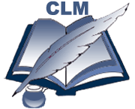


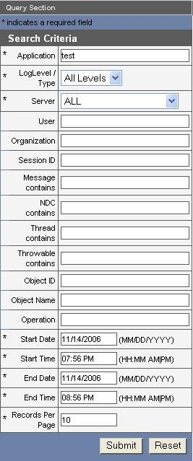
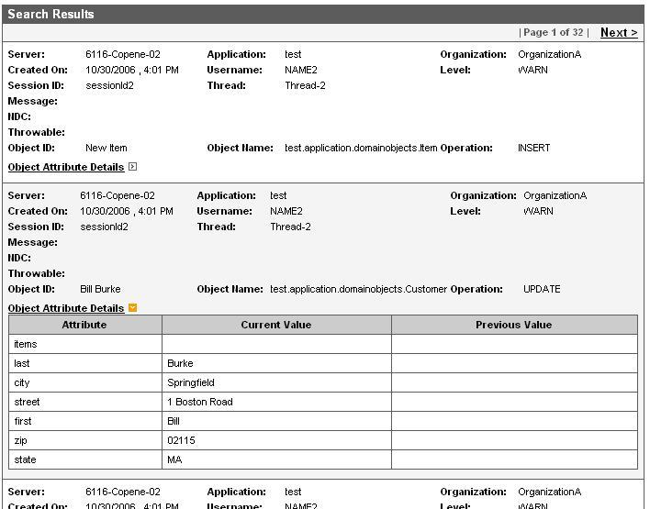
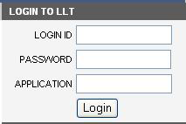

Common Logging Module (CLM)
Kunal Modi, Satish Patel , Vijay Parmar - Ekagra Software Technologies
Aynur Abdurazik - SAIC
Avinash Shanbhag, David Hau, Denise Warzel, Sichen Liu– NCI CBIIT
Ekagra
Overview
The Common Logging Module (CLM) is a set of tools that provide a flexible and comprehensive solution for auditing and logging. The components include Event Logging, Automated Object State Logging, Asynchronous Logging to database, Query Interface, and Web-based Log Locator Tool.
CLM has the following benefits:
Event Logging such as login, logout, actions performed, etc.
Track object state changes in the application for detailed auditing trail.
Helps applications to become 21 CFR Part 11 compliant.
Granular and configurable security enforced for viewing of logs of various applications.
Overall Architecture and Workflow
Features
Event Logging - A log4j-based solution allowing users to log events. Since this feature provides the ability to propagate and store user information, it can be used for auditing a user, detecting security breaches , etc.
Automated Object State Logging - Automated, hibernate based, object‘s state logging mechanism used to log changes to an objects state.
Asynchronous Logging to database - A log4j based JDBC appender that logs messages to the database asynchronously to increase performance of applications that generate a high volume of log messages.
Query APIs - An interface to query log messages programmatically. The Query APIs allow specifying a search criteria and methods to retrieve the results.
Log Locator Tool - This tool is a web-based application that searches, filters and displays, log messages. The GUI interface or Query API can be used to retrieve logs based on a timestamp, user ID, log level, etc.
Log Locator Tool Workflow
Login
Search Logs
View Logs
Application server
Standalone Application
Web Application
Standalone Log Locator Tool leverages CLM API to persist logs generated into the CLM schema
Application Server
Log4J
Log4J
Log Locator Tool leverages CLM API to retrieve logs from the CLM Schema
CLM’s Log Locator Tool
CLM API
CLM API
CLM API
Log Message
Log Message
LLT Utilizes CSM for Authentication and Authorization to restrict users based on organizations, object name, user and Application name.
CSM API
CLM’s Log4j JDBC APPENDER
CLM’s Log4j JDBC APPENDER
CSM Database
CLM Database (Logs)
Adopters
Commons Security Module
caCORE SDK
CTODS Lab Viewer

